Slide 1

Deep Learner Final Project
IMDb Movie Rating Prediction
Shuting Cai Siddharth Das Mrunalini Devineni Yue Li
Introduction to Data Science - DATS 6101

Slide 2
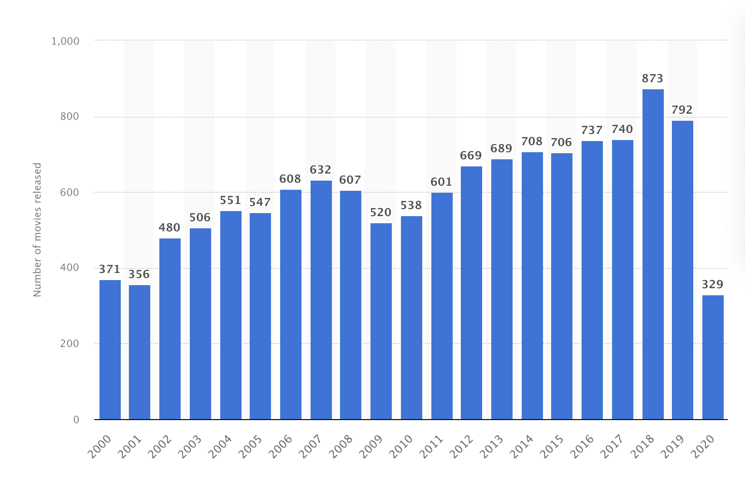

Background
The number of movies released each year is increasing.
873 movies were released in 2018 in the North America.
Movie rating is the main factor for the audience to choose movies.
Figure 1. the number of movies released each year from 2000 to 2020

Slide 3
Smart Questions:
We want to recommend movies to audiences with higher quality.
Can we built a model to predict movies rating based on movie features ?
Which features are important to decide whether this movie is successful or not?

Slide 4
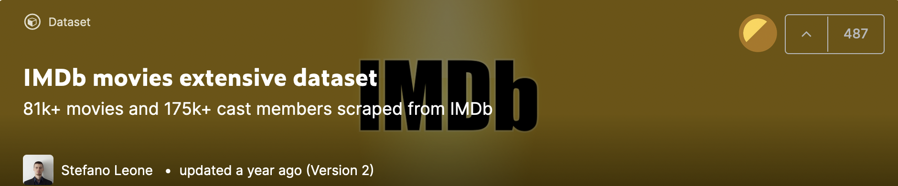
Dataset Description
IMDb movies extensive dataset from Kaggle.
IMDb is an online database of information related to movies, TV series.

Slide 5
Dataset Description
This dataset includes:
85,855 movie description instances
Movie characters: Published year, Genre, Duration, Director, Budget, Movies title, Country, Language, Actors.
Vote information: Vote numbers, Average rate, Votes of different gender and age.
Popularity

Slide 6
Dataset Description
Target: Movie rating (Average vote)
Features: 7 variables
Numerical Features | Categorical Features
Duration | Genre
Budget | Directors
Year Released | Actors
Votes

Slide 7
Preprocessing -- Target Variable
Movie rating (Average vote)
Recommend high-quality movies : Classification Model
Divided into Two categories based on median value
Transformed into ‘0’, ‘1’
Predict Movie Rating : Linear Regression Model
Range: 0-10

Slide 8
Preprocessing -- Features
Numeric:
Duration & Year & Budget & Votes
Year Categorical
Duration
❌

Slide 9
Preprocessing -- Features
Numeric:
Duration & Year & Budget & Votes
Missing Values
Separate Currency code with the numerical number
Converted non-US dollar into US dollar
Scaling: log(budget)

Slide 10
Preprocessing -- Features
Numeric:
Duration & Year & Budget & Votes
Missing Values
Normalization: log(Votes)

Slide 11
Preprocessing -- Features
Categorical: Genre & Actors & Directors
Subdivision of Genre to genre columns
Found out the weighted average of Actors with the average vote

Slide 12
Preprocessing -- Features
Categorical: Genre & Directors & Actors
Found out the historical average vote for movies of different directors
Split the average vote into Quantiles

Slide 13
Preprocessing
Final steps
Missing values were dropped.
Normalization
Numerical values were scaled
log(budget)
log(votes)
(reviews from users) / 100
(reviews from critics) / 100
Split Train and Test data set

Slide 14
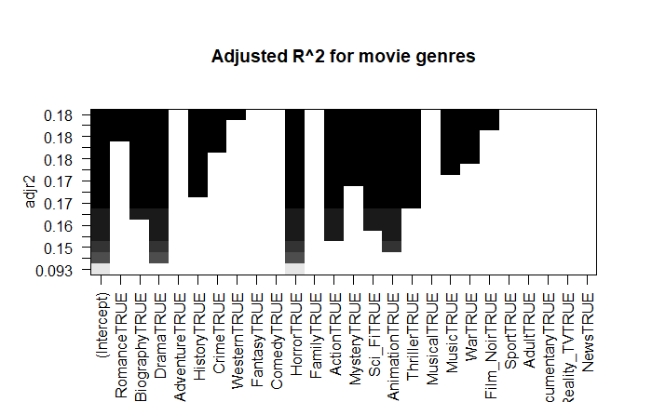
Feature Selection
"Romance" "Biography"
"Drama" "History"
"Crime" "Horror"
"Action" "Mystery"
"Sci_Fi" "Animation" "Thriller" "Musical"
"War" "Film_Noir"
Figure 2. The Adjusted R^2 plot.

Slide 15
Model
Linear Regression Model
Logistic Regression Model
1： good movie (high movie rating)
0: not good movie (low movie rating)

Slide 16
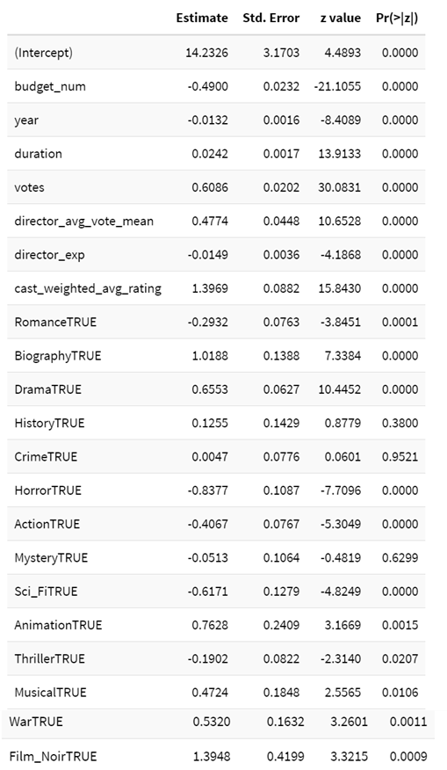
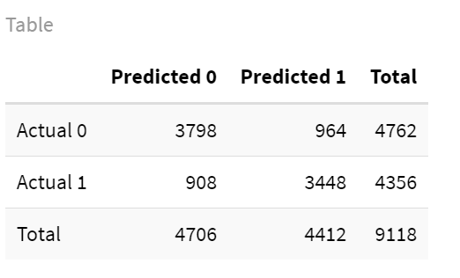
Model - Logistic Regression
Figure 4. The Confusion Matrix.
Figure 3. The Logistic Regression Table.

Slide 17
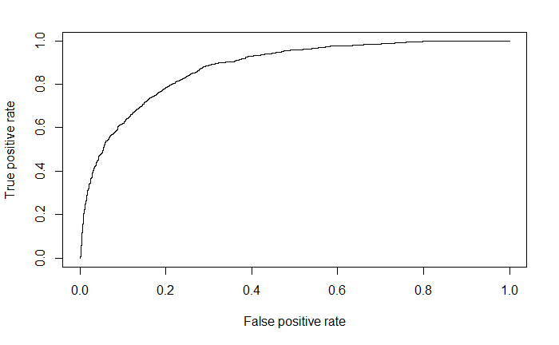
Model - Logistic Regression
Area under the curve:
0.878
Figure 5. The ROC Curve.

Slide 18
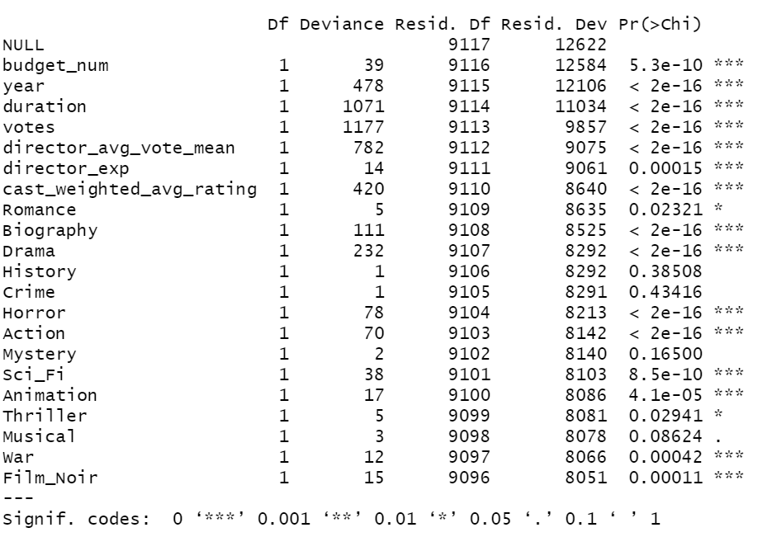
Results -- Evaluation
Adding the numerical variables of budget, year, duration, votes significantly reduces the residual deviance.
The genre of Romance, Biograph, Drama, Horror, Action, Sci_Fi, Animation have a low p-value.
Figure . The Chi squared test results.

Slide 19
Results
Train - 0.7
Results of accuracy:
79.46%
Test - 0.3
Results of accuracy:
79.17%

Slide 20
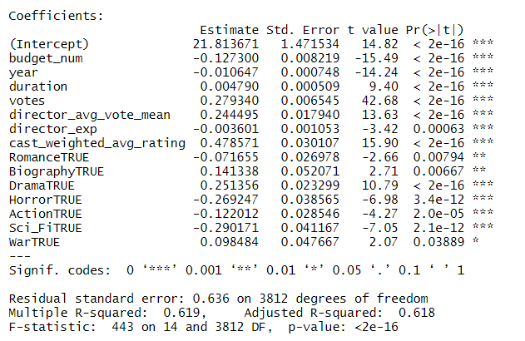
Model - Linear Regression

Slide 21
Model - Linear Regression
Train - 0.7
R-squared value
62%
Test - 0.3
R-squared value
57.2%

Slide 22
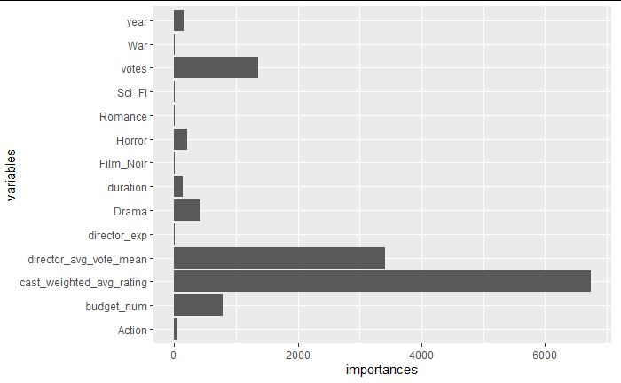
Model - Decision Tree Regressor
Feature Importances

Slide 23
Conclusions
We proposed a way to recommend movies to audiences with higher rating using classification techniques.
We built regression models that accurately predict the average movie rating.
We found features that have the most effect on the target variable and their relative importances.
Further, this could be improved by performing different feature selection techniques, PCA,and other better classification models .

Slide 24
Thank you

